Slide 1


Components - Basic Usage
Reusable Pieces, Component Communication
SoftUni Team
Technical Trainers
Software University
http://softuni.bg

Slide 2
Table of Contents
Components Overview
Declaration
Reusability & Data
Props
Emitting Events
CLI Project Environment

Slide 3
Have a Question?
sli.do #vue-js

Slide 4
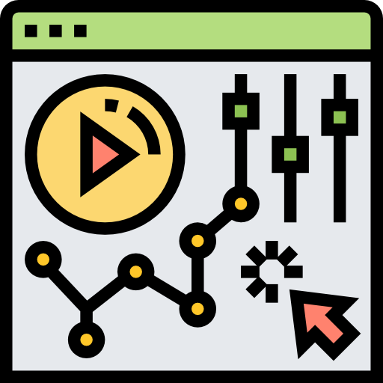
Components Overview
Declaration, Reusability, Data

Slide 5
What is a Component?
Components are reusable Vue instances with a name (selector)
They have data, computed, methods, watch properties
Each component is designed to be as simple as possible
Split the application into multiple components
Header, Footer, Navigation, Product List, Product Item

Slide 6
Component Declaration
Each component must be first registered
Locally or Globally
Has a unique selector which starts with app-
The data must be a function which returns an object literal
The template of the component can be:
Inline - a property inside the instance
External - inside the <template> tag of the .vue files (Vue CLI)

Slide 7
Declaration
Vue.component('app-counter', {
data: function() {
return {
counter: 0
}
},
template: '<button @click="counter++"> Counter: {{ counter }}
</button>'
});

Slide 8
Selector
Use the selector inside the template like an HTML tag
<div id="app">
<h1>Components</h1>
<app-counter></app-counter>
</div>
new Vue({
el: '#app'
});
The root instance is empty

Slide 9
Reusing Components
Components can be reused as many times as you want
Each component maintains it's own state
<div id="app">
<app-counter></app-counter>
<app-counter></app-counter>
<app-counter></app-counter>
<app-counter></app-counter>
</div>

Slide 10
Component Data
The data option must be a function
Each instance maintains an independent copy of the data
data: function () {
return {
count: 0,
items: [ 'First', 'Second', 'Third' ]
}
}

Slide 11

Props
Communication - Parent to Child

Slide 12
Props
Components communicate with each other all the time (pass data)
To pass data from a parent to a child component - use props
Custom attributes
Value of a prop is received from the parent
Should NOT be mutated
Data flows one-way

Slide 13
Passing Down Data
To pass down a prop use v-bind or the shorthand ":"
<post-item
v-for="post in posts"
v-bind:key="post.id"
v-bind:title="post.title"
></post-item>
Unique identifier for an item

Slide 14
Receiving Data
Each component instance has a "props" option
It can be an array of strings
After it has been passed it becomes a property of that instance
<script>
export default {
props: [ 'title' ]
}
</script>

Slide 15
Props Mutation
Props are meant to be read-only
Data flows one-way
export default {
props: [ 'title' ],
methods: {
changeTitle() {
this.title = 'New';
}
} }
Throws an error on the console

Slide 16
Props Naming
HTML attribute names are case-insensitive
Vue.component('blog-post', {
// camelCase in JavaScript
props: [ 'postTitle' ],
template: '<h3>{{ postTitle }}</h3>'
});
// kebab-case in HTML
<blog-post post-title="hello!"></blog-post>

Slide 17

Emitting Events
Communication – Child to Parent

Slide 18
Emitting Events
Sometimes communicating back up to the parent is required
Vue provides a custom event system to achieve this
Call the $emit function inside the child to create a custom event
The parent receives a notification about the custom event with v-on or the shorthand "@"

Slide 19
Emitting Custom Events
Vue.component('app-post-item', {
props: [ 'counter' ],
methods: {
increase() {
this.$emit('onIncrease', this.counter + 1);
}
},
template: `<button @click="increase()">Increase</button>`
};
Custom Event Name
Emitted Value

Slide 20
Handling Custom Events
Handle the event inside the parent component
<div>
<h1>{{ counter }}</h1>
<app-post-item
:counter="counter"
@onIncrease="counter = $event">
</app-post-item>
</div>
The Emitted Value (counter + 1)

Slide 21

CLI Project Environment
Single-File Templates

Slide 22
The Vue CLI
The Vue CLI is a powerful tool
Webpack, Babel, Single-File Templates
Webpack bundles files during build process
Babel transpiles the ES6 code
Each component has it's own .vue file also called a Single-File Template

Slide 23
Single-File Template
The <template> is the component's HTML
<template>
<div>
<h1>Vue CLI</h1>
<p>Root Component</p>
<button @click="counter++">
Value {{ counter }}
</button>
</div>
</template>
Each template must have a root element

Slide 24
Single-File Template
The <script> is the component's declaration and other imports
export default {
// Use "import" to include other scripts
data: function() {
return {
counter: 0
}
}
}

Slide 25
Single-File Template
The <style> applies global styling by default
<style>
div {
background-color: gray;
margin: 20px;
padding: 35px;
border: 2px solid black;
}
</style>
Applies the style on ALL div elements

Slide 26
Scoping Styles
Add the "scoped" attribute
Applies style encapsulation to a single component
Similar to the Shadow DOM in Angular
<style scoped>
.example {
color: red;
}
</style>

Slide 27
Global Registration
Globally registered components can be used inside the <template> of any root Vue instance
Can be registered inside main.js
Use the import syntax to include it
import HeaderComponent from './components/Header'
Vue.component('app-header', HeaderComponent)

Slide 28
Local Registration
Locally registered components can ONLY be used inside the template of the current Vue instance
<script>
import HeaderComponent from './components/Header'
export default {
components: {
'app-header': HeaderComponent
}
}
</script>
Can also be appHeader

Slide 29
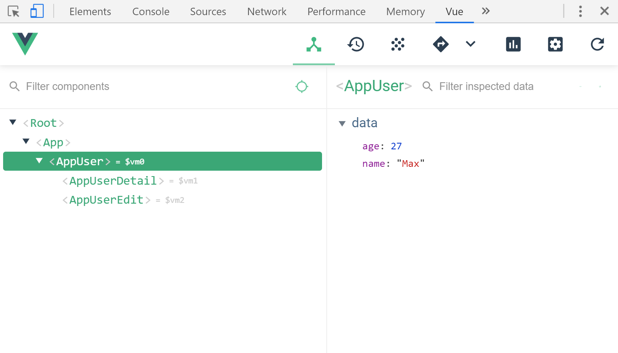
Vue.js Devtools
Install the official devtools for inspecting Vue elements
Chrome download link

Slide 30

Summary
…
…
…
Components are reusable Vue instances
The Vue CLI generates Single-File Templates
Props are used to pass down data
Emitting custom events
The Event Bus – centralized event manager

Slide 31
https://softuni.bg/trainings/2430/vuejs-fundamentals-july-2019

Slide 32












SoftUni Diamond Partners

Slide 33




SoftUni Organizational Partners

Slide 34





Trainings @ Software University (SoftUni)
Software University – High-Quality Education, Profession and Job for Software Developers
softuni.bg
Software University Foundation
http://softuni.foundation/
Software University @ Facebook
facebook.com/SoftwareUniversity
Software University Forums
forum.softuni.bg

